Slide 1

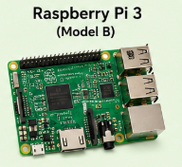





Display Emotion through Color
Show Emotion
Moves Robot hand
Give Sound

Slide 2
Start
Power on
Captures photo
Raspberry Pi 3 Active
NO
Detect Emotion?
No Output
YES
Show RGB Color
Display on OLED
Move servo motor
Play Sound
Interactive Response
Stop

